Slide 1
Data Science – 19CS2205S
Skilling 1

Slide 2
Applications of Data Preparation
INTRODUCTION TO PANDAS
Include .csv file in python
1. Use series method to convert the following list [‘a’,’b’,’c’,’d’]
2. Given the lists which contain names of students and their scored marks you have to create data frames which club them all using pandas. student list is [' Name 1' ,' Name 2', ' Name 3' ,' Name 4', ' Name 5' ' Name 6'] and you are given a 2d matrix which contain their marks. Their marks are [[67,89,68,95], [87,94,97,76], [77,85,99,74], [90,89,92,78], [83,97,80,98],[90,90,80,87]] and subjects list containing ['DS','AI','MPII', 'CNS']
3. Add the TS , total columns to the data frame from which TS is the sum of DS,AI,MPII and total is the sum of all subjects?
4. Display only the marks scored by Name 2 and Name3?
5. Display all the students marks who scored 90 + marks in DS?
6. DS teacher wants to know the total marks achieved by students in AI, Help her by using the sum method in data frame

Slide 3
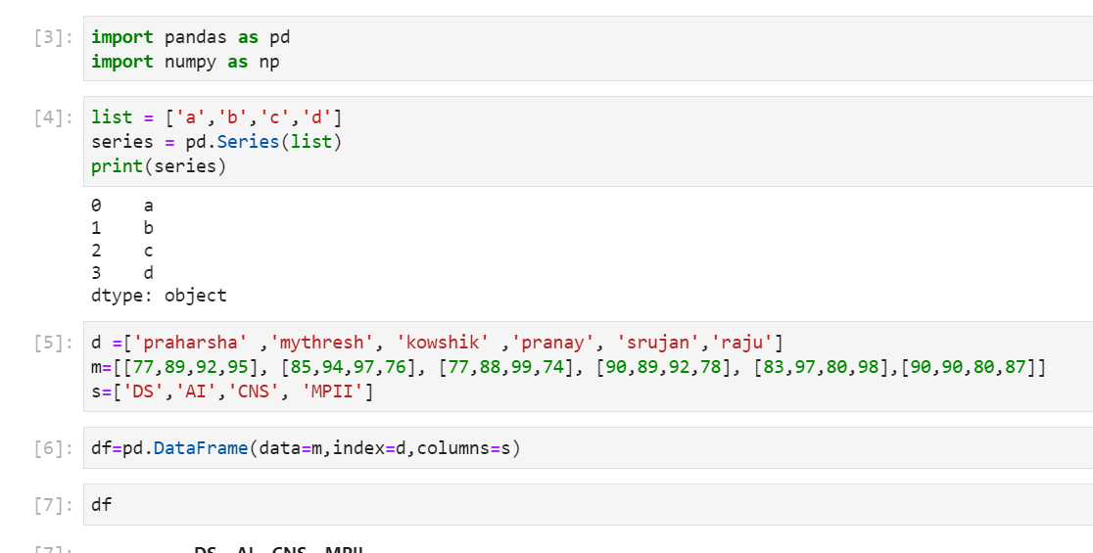

Slide 4
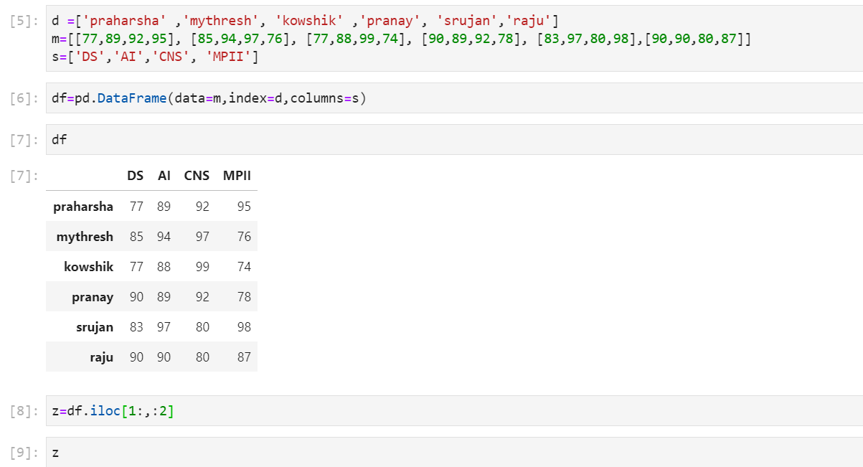

Slide 5
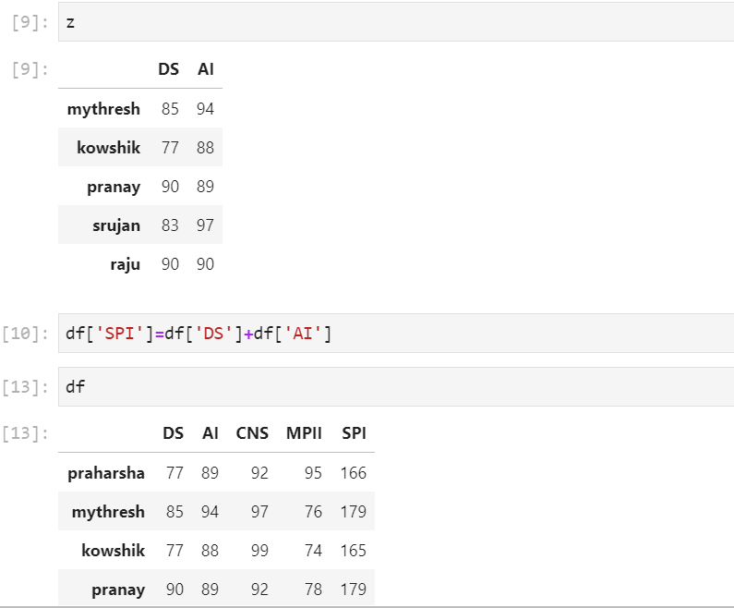

Slide 6
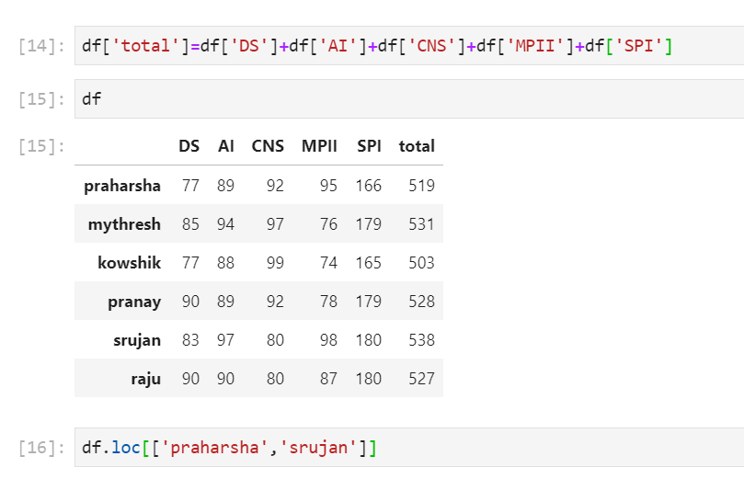

Slide 7
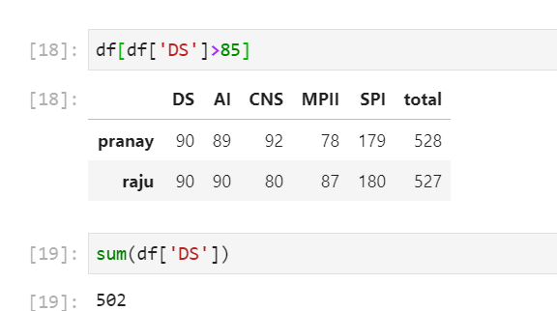

Slide 8
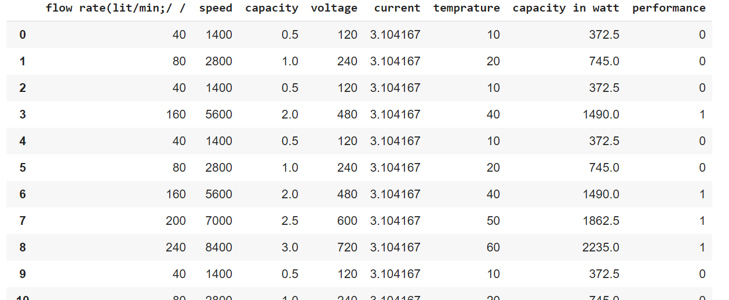
.CSV file-dataset =pd.read_csv('motor.csv')

Slide 9
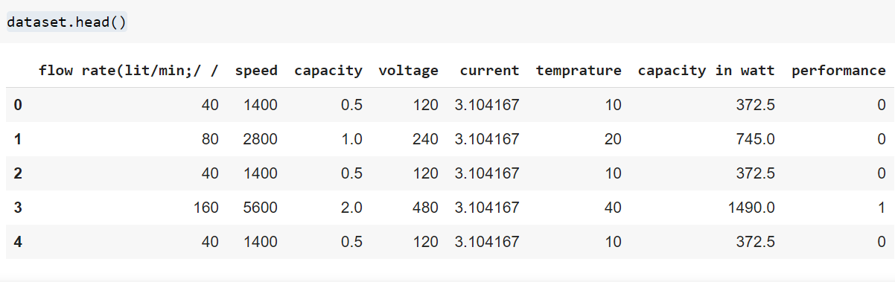
dataset
dataset.head()

